Slide 1
MOBILE TECHNOLOGIES
THE PAST, PRESENT AND FUTURE

Slide 2
MOBILE TECHNOLOGIES
Mobile technology is exactly what the name indicates – technology that is portable; it refers to any device that you can carry with you to perform a wide variety of “tasks”. It is technology that allows those tasks to be performed via cellular phone, PDA, vehicles, laptops, etc.

Slide 3
MOBILE apps
A TRAVEL THROUGH HISTORY

Slide 4
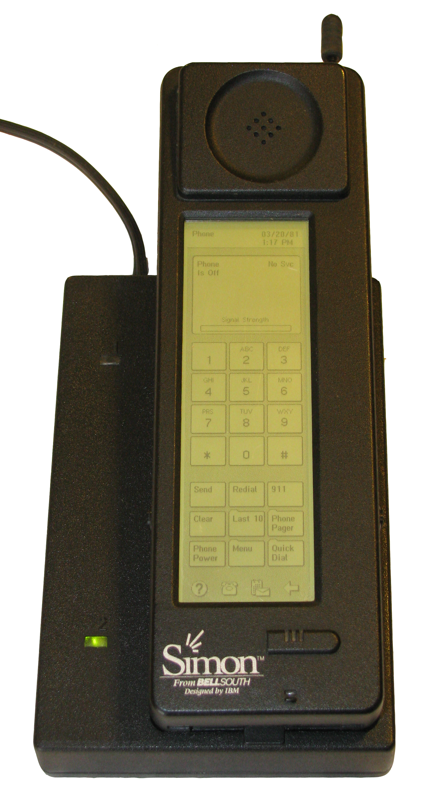
1993
IBM BEGINS SELLING SIMON, WHICH PAVES THE WAY FOR MODERN SMARTPHONES BY INCLDUDING A TOUCHSCREEN INSTEAD OF BUTTONS.

Slide 5
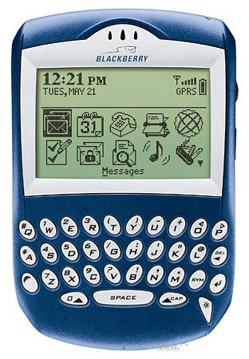
2002
RIM RELEASES ITS FIRST BLACKBERRY DEVICES WITH INTEGRATED PHONE FUNCTIONALITY: THE PRODUCT LINE EVENTUALLY EVOLVES INTO THE FIRST MASS-MARKET SMARTPHONE OPTIMIZED FOR WIRELESS EMAIL

Slide 6
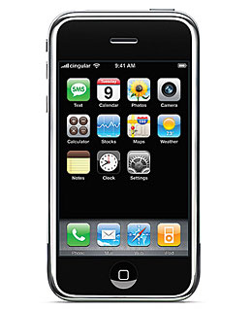
2007
APPLE RELEASES THE FIRST IPHONE, WHICH COMES WITH ONLY THE DEFAULT APPS PRELOADED ON THE PHONE, INCLUDING:
MAPS
PHOTOS
TEXTS
WEATHER

Slide 7

JULY 2008
APPLE LAUNCHES THE APP STORE AND IPHONE 3G

Slide 8

October 2008
GOOGLE LAUNCHES ANDROID MARKET
HTC RELEASES THE HTC DREAM, THE FIRST COMMERCIALLY AVAILABLE ANDROID SMARTPHONE

Slide 9

APRIL 2010
APPLE RELEASES FIRST IPAD

Slide 10

OCTOBER 2010
WINDOWS PHONE IS LAUNCHED

Slide 11
2011
“APP” VOTED WORD OF THE YEAR 2010
TOTAL APPLE APP STORE APP DOWNLOADS EXCEED 10 BILLION
APPLE RELEASES IPAD2
APPLE RELEASES IPHONE 4S
TOTAL NUMBER OF APPS REACHES 1 MILLION
APP USAGE SURPASSES MOBILE WEB USAGE

Slide 12
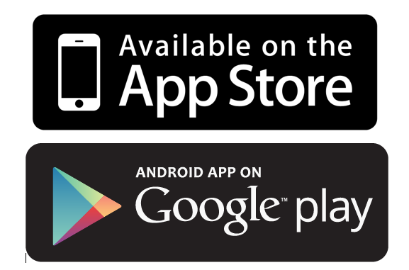
July 2013
GOOGLE PLAY AND APPLE STORE REACH OVER 50 BILLION DOWNLOADS EACH

Slide 13
2014
GMAIL BECOMES FIRST STANDALONE APP TO HIT 1 BILLION DOWNLOADS
APPLE JOINS THE MOBILE PAYMENT MARKET WITH APPLE PAY
WINDOWS PHONE 8.1 RELEASED
BLACKBERRY CLASSIC INTRODUCED
USERS AGED 18 AND OVER SPEND 65% MORE TIME EACH MONTH USING APPS THAN THEY DID 2 YEARS AGO

Slide 14
2015
APPLE REACHES 100 BILLION DOWNLOADS
APPS ACOUNT FOR 88% OF USAGE ON SMARTPHONES

Slide 15
Mobile appS
THE FUTURE

Slide 16
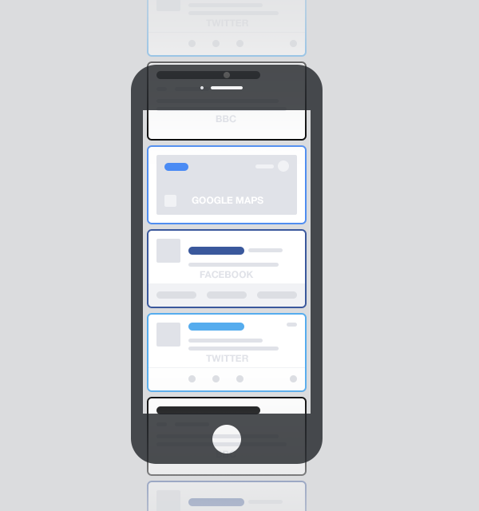
No more apps?
The idea of having a screen full of icons, representing independent apps, that need to be opened to experience them, is making less and less sense. The idea that these apps sit in the background, pushing content into a central experience, is making more and more sense. That central experience may be something that looks like a notification centre today, or something similar to Google Now, or something entirely new.

Slide 17
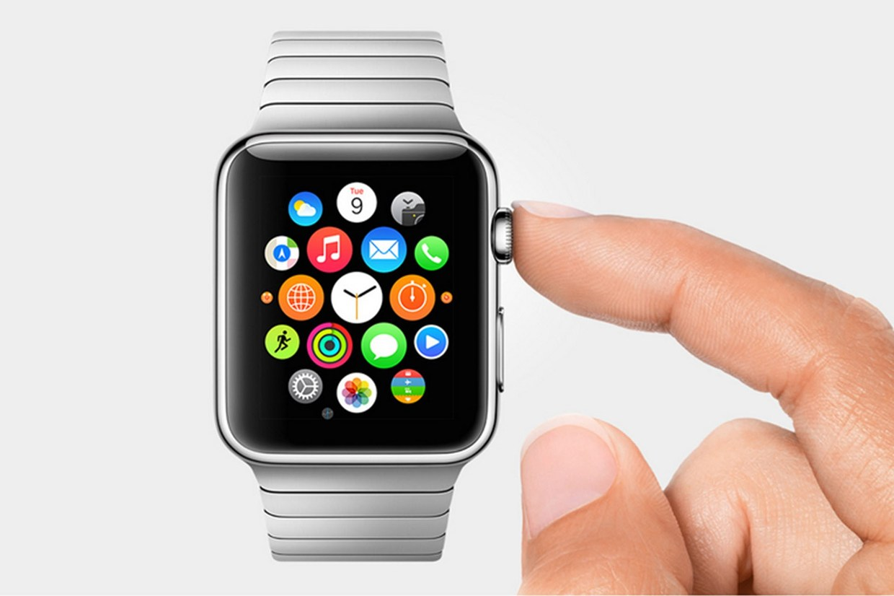
APPS IN OUR HANDS
AS SMARTPHONES AND WEARABLE TECHNOLOGY IMPROVES, MOBILE APPS WILL NEED TO KEEP UP IN ORDER TO ADEQUATELY DELIVER INFORMATION IN NEW WAYS

Slide 18
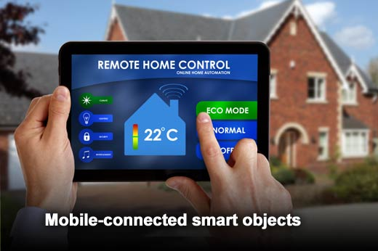
MOBILE CONNECTED SMART-OBJECTS
BY 2020, THE MARKET WILL CONTAIN SEVERAL HUNDRED SMART OBJECTS, INCLUDING LED LIGHT BULBS, TOYS, DOMESTIC APPLIANCES, SPORTS EQUIPMENT, MEDICAL DEVICES AND CONTROLLABLE POWER SOCKETS

Slide 19
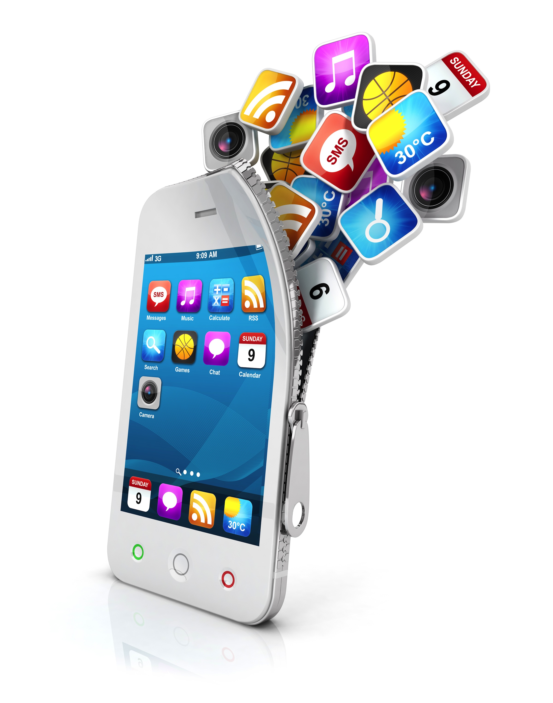
DEVELOPING APPS IN APPS?
Most organizations will need application development tools to support three key platforms (Android, iOS and Windows) and three application architectures (native, hybrid and mobile Web). most large organizations will need a portfolio of several tools to deliver to the architectures and platforms they require.

Slide 20
THE END

Slide 21
FRANK COBBY
COB143419@STUDENTID.CITYBATHCOLL.AC.UK

